Slide 1


Hotel Booking Cancellation Prediction Business Case II
Group I
Emanuele Aldera, Robin Schmidt, Muhammad Abdullah, Rui Ramos

Slide 2
Agenda
1. Intro & Business understanding
2. Data Preprocessing
3. Data Transformation
4. Data Exploration
5. Feature Selection
6. Cross Validation
7. Oversampling
8. Modeling

Slide 3
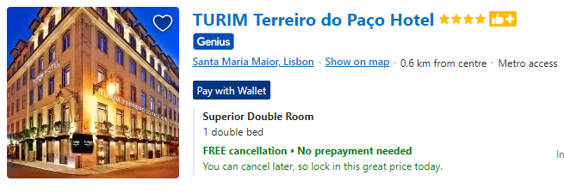
Intro & Business understanding
example illustration
City hotel in Lisbon
Management team has the goal to increase revenue
They hired our company to build the analysis and to help to understand how to improve their business effectiveness
The data provided was a dataset with 79330 observations gathered in two years (Jul 2015 to Aug 2017)

Slide 4
Intro & Business understanding
OTA’s are in our days a way to satisfy more the customers but….
Bring more competition between hotels
Easier ways to book and to cancel / more deal seeking
Inability to predict based on seasonality, and so on…
Revenue from canceled bookings ~43%
Bookings canceled ~42%
By decreasing by 20% the cancelation rate we can increase total revenue
Average value for ADR (Average Daily Rate) = 105 €
Leadtime average = 109 days
Duration of stay average = 3 days
New customers ~ 97%
Old Customers ~3%

Slide 5
Data Preprocessing
Feature Engineering
Date Transformation
Duration of Stay
Total Value
Is Room Changed
Duplicates
32% detected as duplicates
Group-related duplicates reduced to 1 entry → 14.3%
Missing Values
Children (4), Country (24)
Replaced with most common value

Slide 6
Data Transformation
v
Scaling
Metric Features
Standard-Scaler (mean = 0, std =1)
Outliers
e.g. ADR with 5.400, Babies with 10
One-Class Support Vector Machine (nu = 0.02)
Reducing Cardialities
High Cardinality Features: Company, Agent, Country,…
Rare Occurences replaces with category „Others“
Encoding
Label Encoding
One-Hot-Encoder

Slide 7
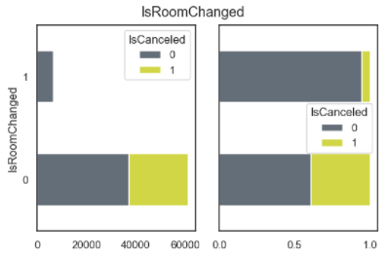
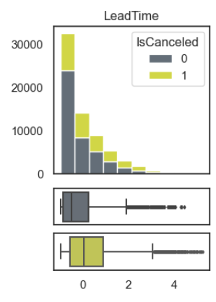
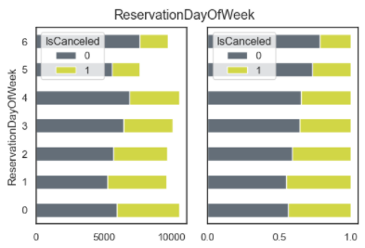
Data Exploration

Slide 8
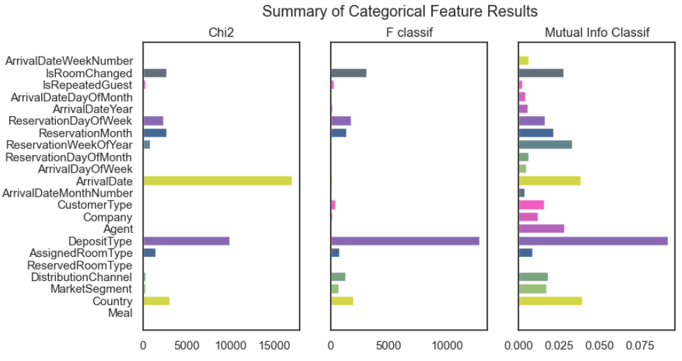
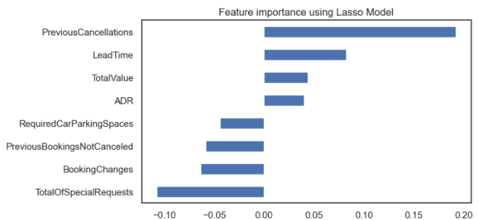
Feature Selection
Categorical (Chi2, F-classif, Mutual Info Classifier)
IsRoomChanged, IsRepeatedGuest, ReservationDayOfWeek,
ReservationMonth, CustomerType, Company, Agent,
DepositType, AssignedRoomType,
DistributionChannel, MarketSegment and Country.
Metric (Lasso, Mutual Info Classifier, Isolation Forest, Fisher Score)
PreviousCancellations, LeadTime, TotalValue,
RequiredParkingSpaces, PreviousBookingNotCancele,
BookingChanges, TotalOfSpecialRequest
The encoded categorical and metric
features were later combined

Slide 9
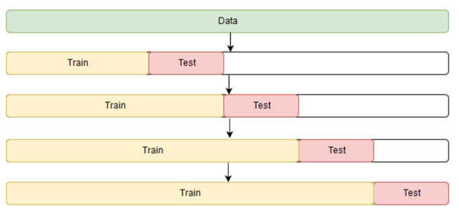
Cross Validation
Split
Sort values by Reservation Status Date
Splitting the dataset 70/30 for training and testing data
Time Series Split
Maintain the chronological order to always train past data to predict future outcomes (validation set)
Imbalanced target variable
Oversampling using SMOTE technique
Same cardinality (50/50) on both training and testing data

Slide 10
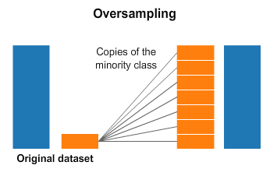
Oversampling
… SMOTE first selects a minority class instance a at random and finds its k nearest minority class neighbors. The synthetic instance is then created by choosing one of the k nearest neighbors b at random and connecting a and b to form a line segment in the feature space. The synthetic instances are generated as a convex combination of the two chosen instances a and b.
— Page 47, Imbalanced Learning: Foundations, Algorithms, and Applications, 2013.

Slide 11
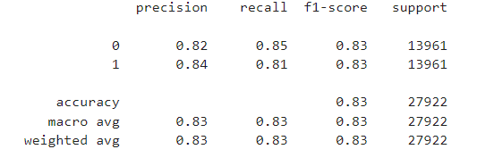
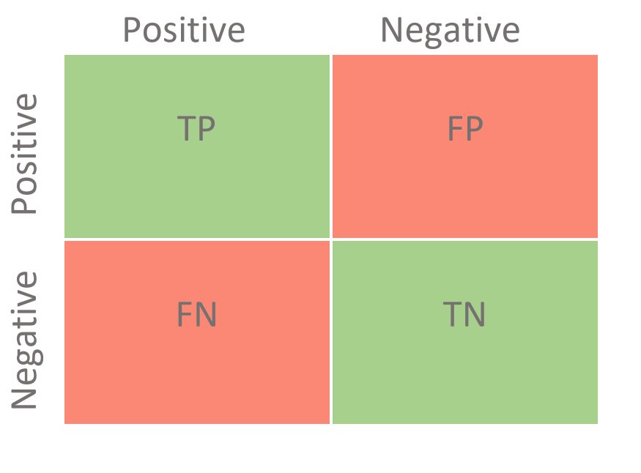
Modelling
Tested the data with 3 different models
Logistics Regression
Decision Trees
Random Forest (Tuned with GridSearch)
11840
2121
2625
11336

Slide 12
Business Approach
Importance of not only predicting TP and TN but also FP and FN – Direct effect on the revenue stream
FP - non-cancellation are predicted to be cancellations - Overbooking; if imbalanced may be more costly to the business with cancellation fee
FN - cancellation are predicted to be non-cancellations – Empty Rooms; if imbalanced the rooms may be empty and will effect the opportunity cost to rent

Slide 13
Thank you for your attention!
Emanuele Aldera, Robin Schmidt, Muhammad Abdullah, Rui Ramos

